Slide 1
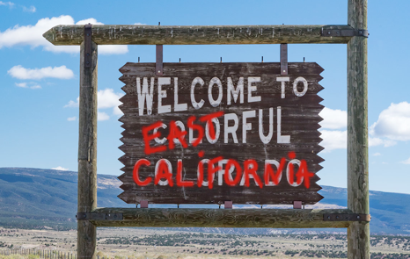
Saving Colorado from becoming California
Independence Institute Policy Primer
February 13, 2018

Slide 2
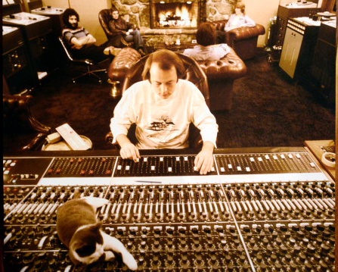

Slide 3
The Colorado Culture - we crave the freedom to make our own decisions

Slide 4
The Colorado Culture - we crave the freedom to make our own decisions
The California Culture - we demand to make decisions for other people

Slide 5
TABOR Preamble
…Its preferred interpretation shall reasonably restrain most the growth of government…

Slide 6
Constitution Constraining General Purpose Revenue TABOR and Referendum C Billions of Dollars
Source: Colorado State Controllers Office and Legislative Council Staff, December 2016 Forecast.

Slide 7
Constitution Constraining General Purpose Revenue TABOR and Referendum C Billions of Dollars
Source: Colorado State Controllers Office and Legislative Council Staff, December 2016 Forecast.

Slide 8
Constitution Constraining General Purpose Revenue TABOR and Referendum C Billions of Dollars
Source: Colorado State Controllers Office and Legislative Council Staff, December 2016 Forecast.

Slide 9
Constitution Constraining General Purpose Revenue TABOR and Referendum C Billions of Dollars
Source: Colorado State Controllers Office and Legislative Council Staff, December 2016 Forecast.

Slide 10
Constitution Constraining General Purpose Revenue TABOR and Referendum C Billions of Dollars
Source: Colorado State Controllers Office and Legislative Council Staff, December 2016 Forecast.

Slide 11
TABOR Preamble
…Its preferred interpretation shall reasonably restrain most the growth of government…
…Other limits on district revenue, spending, and debt may be weakened only by future voter approval…

Slide 12
TABOR is a ghost of what it once was
Ref C, 2005
Enterprises
Four Year “De-Brucings”
Definition of a tax
Definition of debt

Slide 13
State TABOR Limit Billions of Dollars
Revenue Subject to TABOR and Total Revenue
Source: Colorado State Controllers Office, TABOR Schedule of Computations.

Slide 14
TABOR Outlook
Revenue Subject to TABOR
Dollars in Billions
Potential Increase from
the Tax Cuts and Jobs Act*
Referendum C
Five-Year Timeout Period
*Estimates are preliminary and subject to change with additional information.
Source: Colorado Office of the State Controller and Legislative Council Staff December 2017 forecast.

Slide 15
Estimated State Revenue Impacts from the Federal Tax Bill
Estimates are preliminary and subject to change with additional information.
Millions
Current & Next Year
Source: December 2017 Legislative Council Staff forecast.

Slide 17
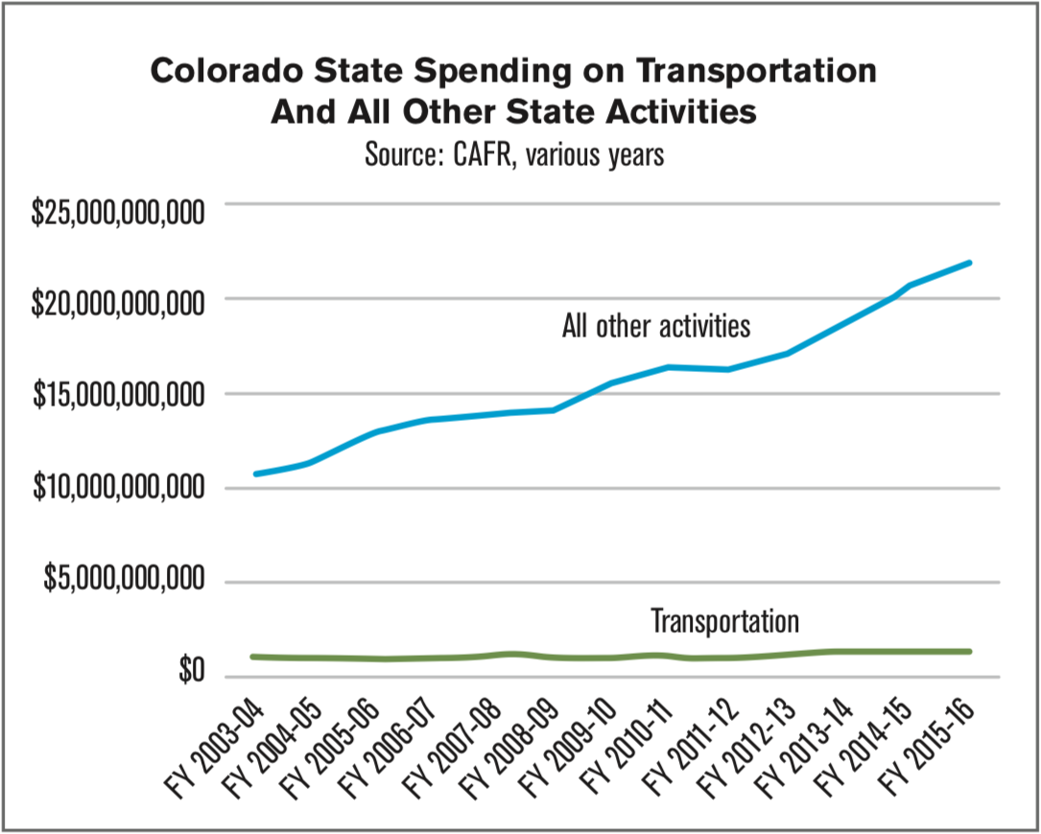

Slide 18
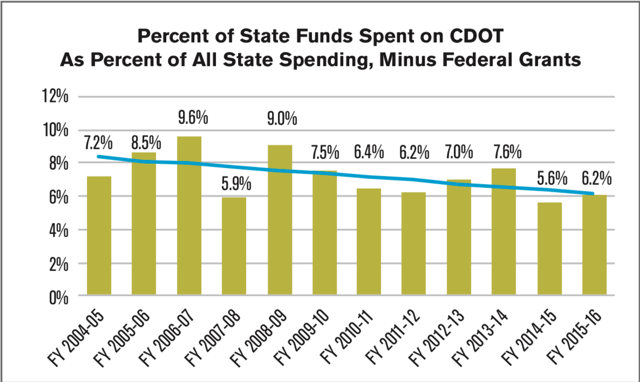

Slide 19
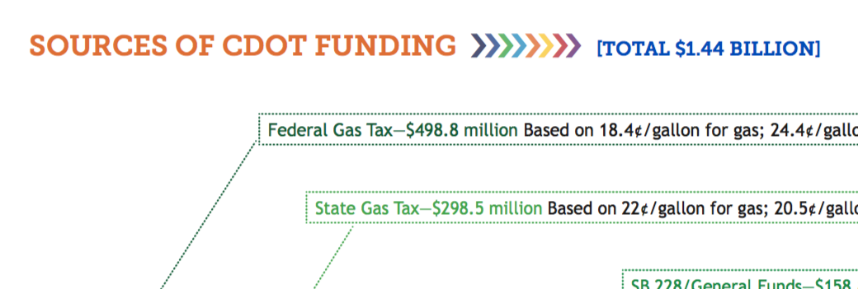

Slide 20
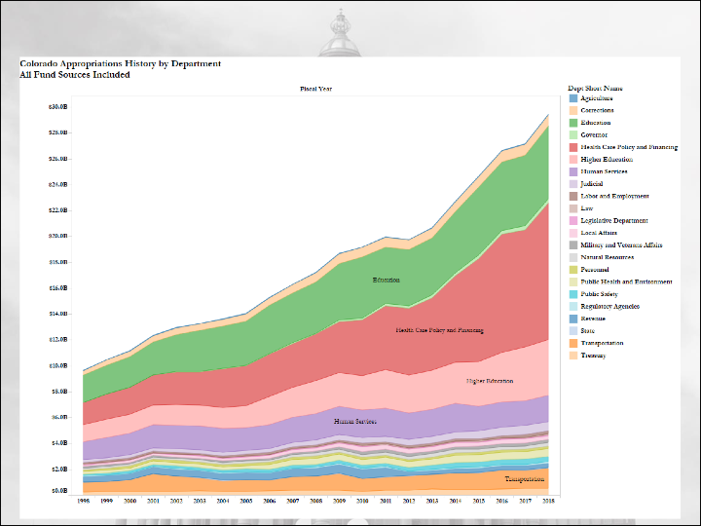

Slide 21
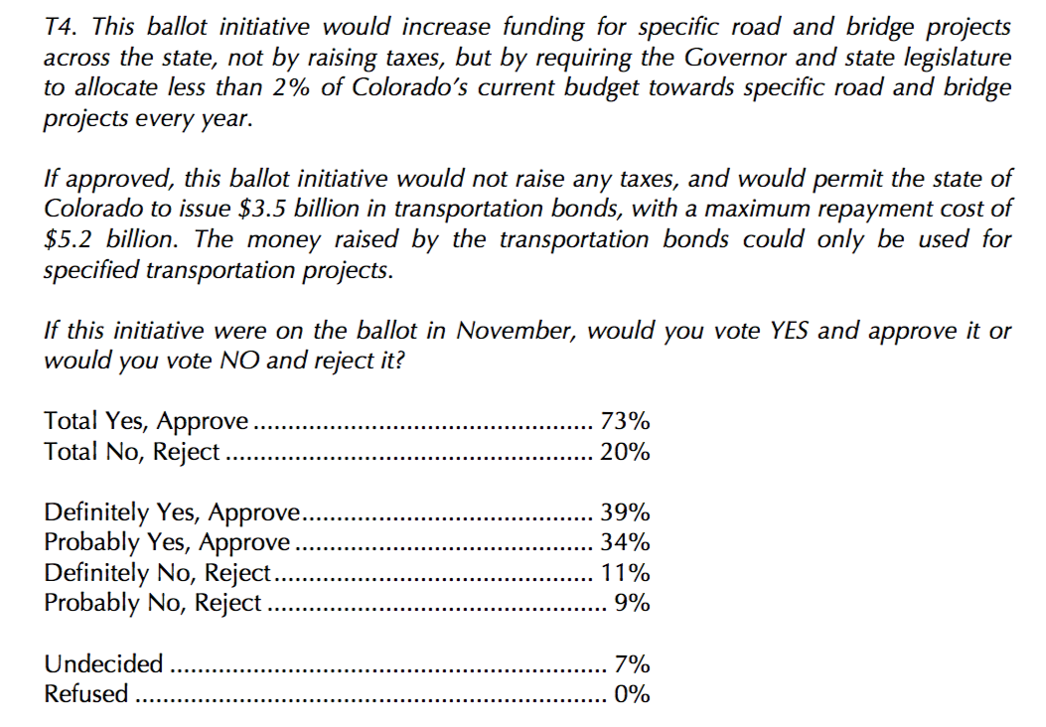

Slide 22
